Slide 1
Abigail Duran
Goals for the week
  Prepare the PCB design files with all currently selected components and required connections.
  Make sure the schematic reflects the components planned for the current BuggyBot hardware setup.
Progress for the week
  Created an organized component checklist/spreadsheet for the PCB design.
  Reviewed the CM5 IO Board components and connections to determine which features should be kept, removed, or modified.
  Removed unnecessary components from both the schematic and PCB layout.
Goals for next week​​​
  Continue developing the PCB design and component placement.
  Begin planning power distribution and signal routing.​
  Work toward finalizing the PCB design for manufacturing.
Hours spent on progress
  6 hours​

Slide 2
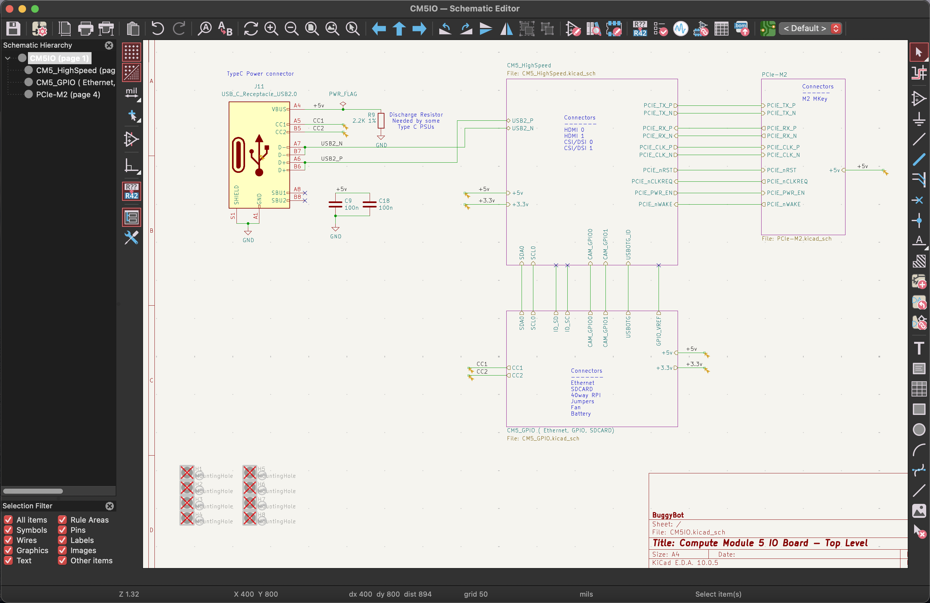

Slide 3
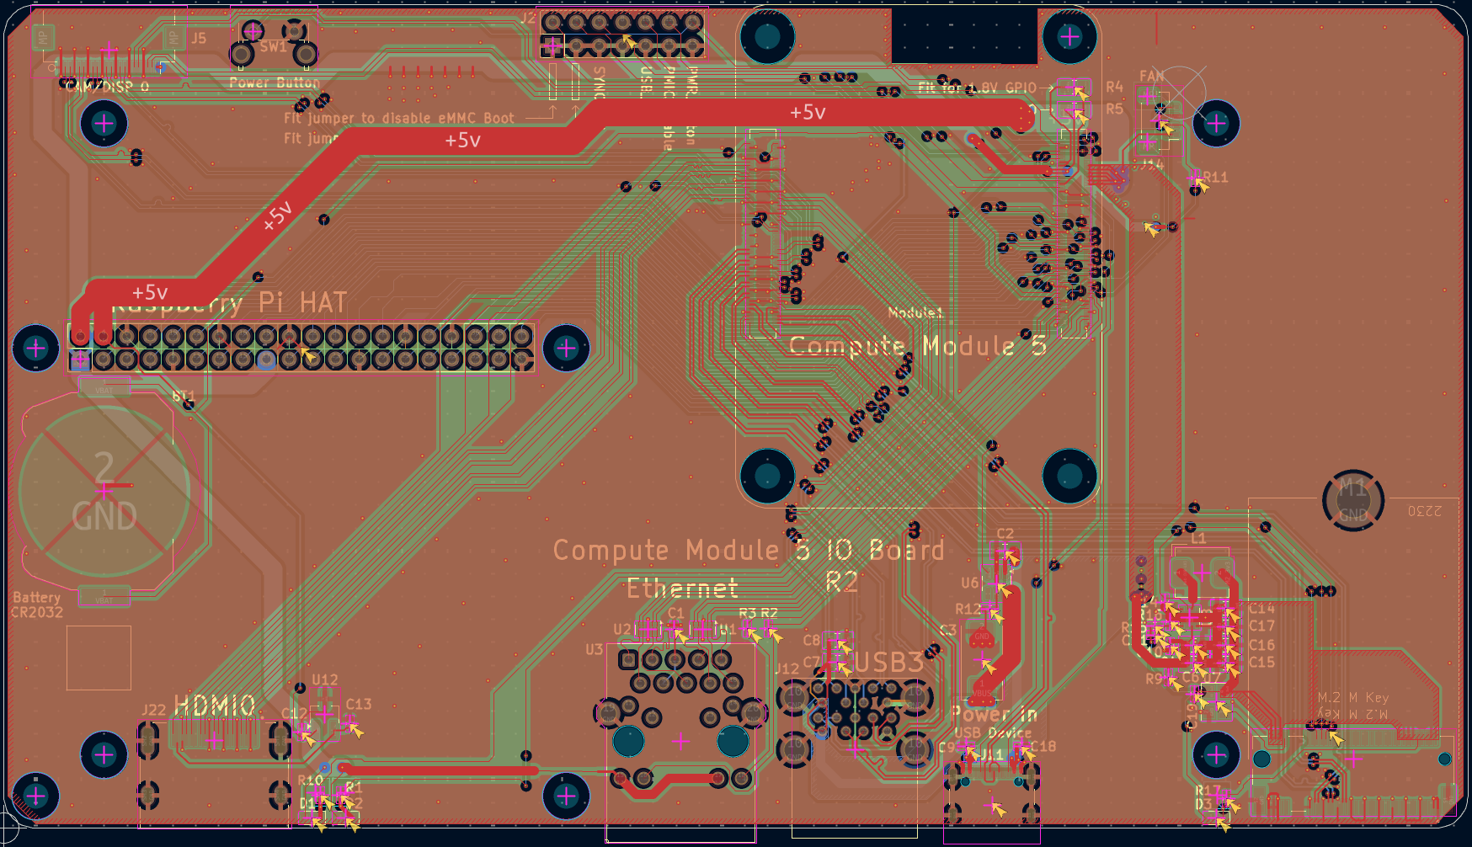

Slide 4
